Slide 1

Tilt/Gesture Controlled Robot
ECE528/L Robotics and Embedded Systems with Lab
Group: Sean Felker, Prachi Patel
Instructor: Aaron Nanas
Fall 2025

Slide 2
Objectives:
The goal of this project is to design sensor-based tilt/ gesture-controlled robot using MSP432 microcontroller and Adafruit Bluefruit LE UART Friend module.
The robot can be controlled by transmitting quaternion sensor readings wirelessly to Bluefruit LE module using the bluefruitConnect app on an iOS smartphone, and then that received data will transmit to MSP432 microcontroller via UART serial communication interface.

Slide 3
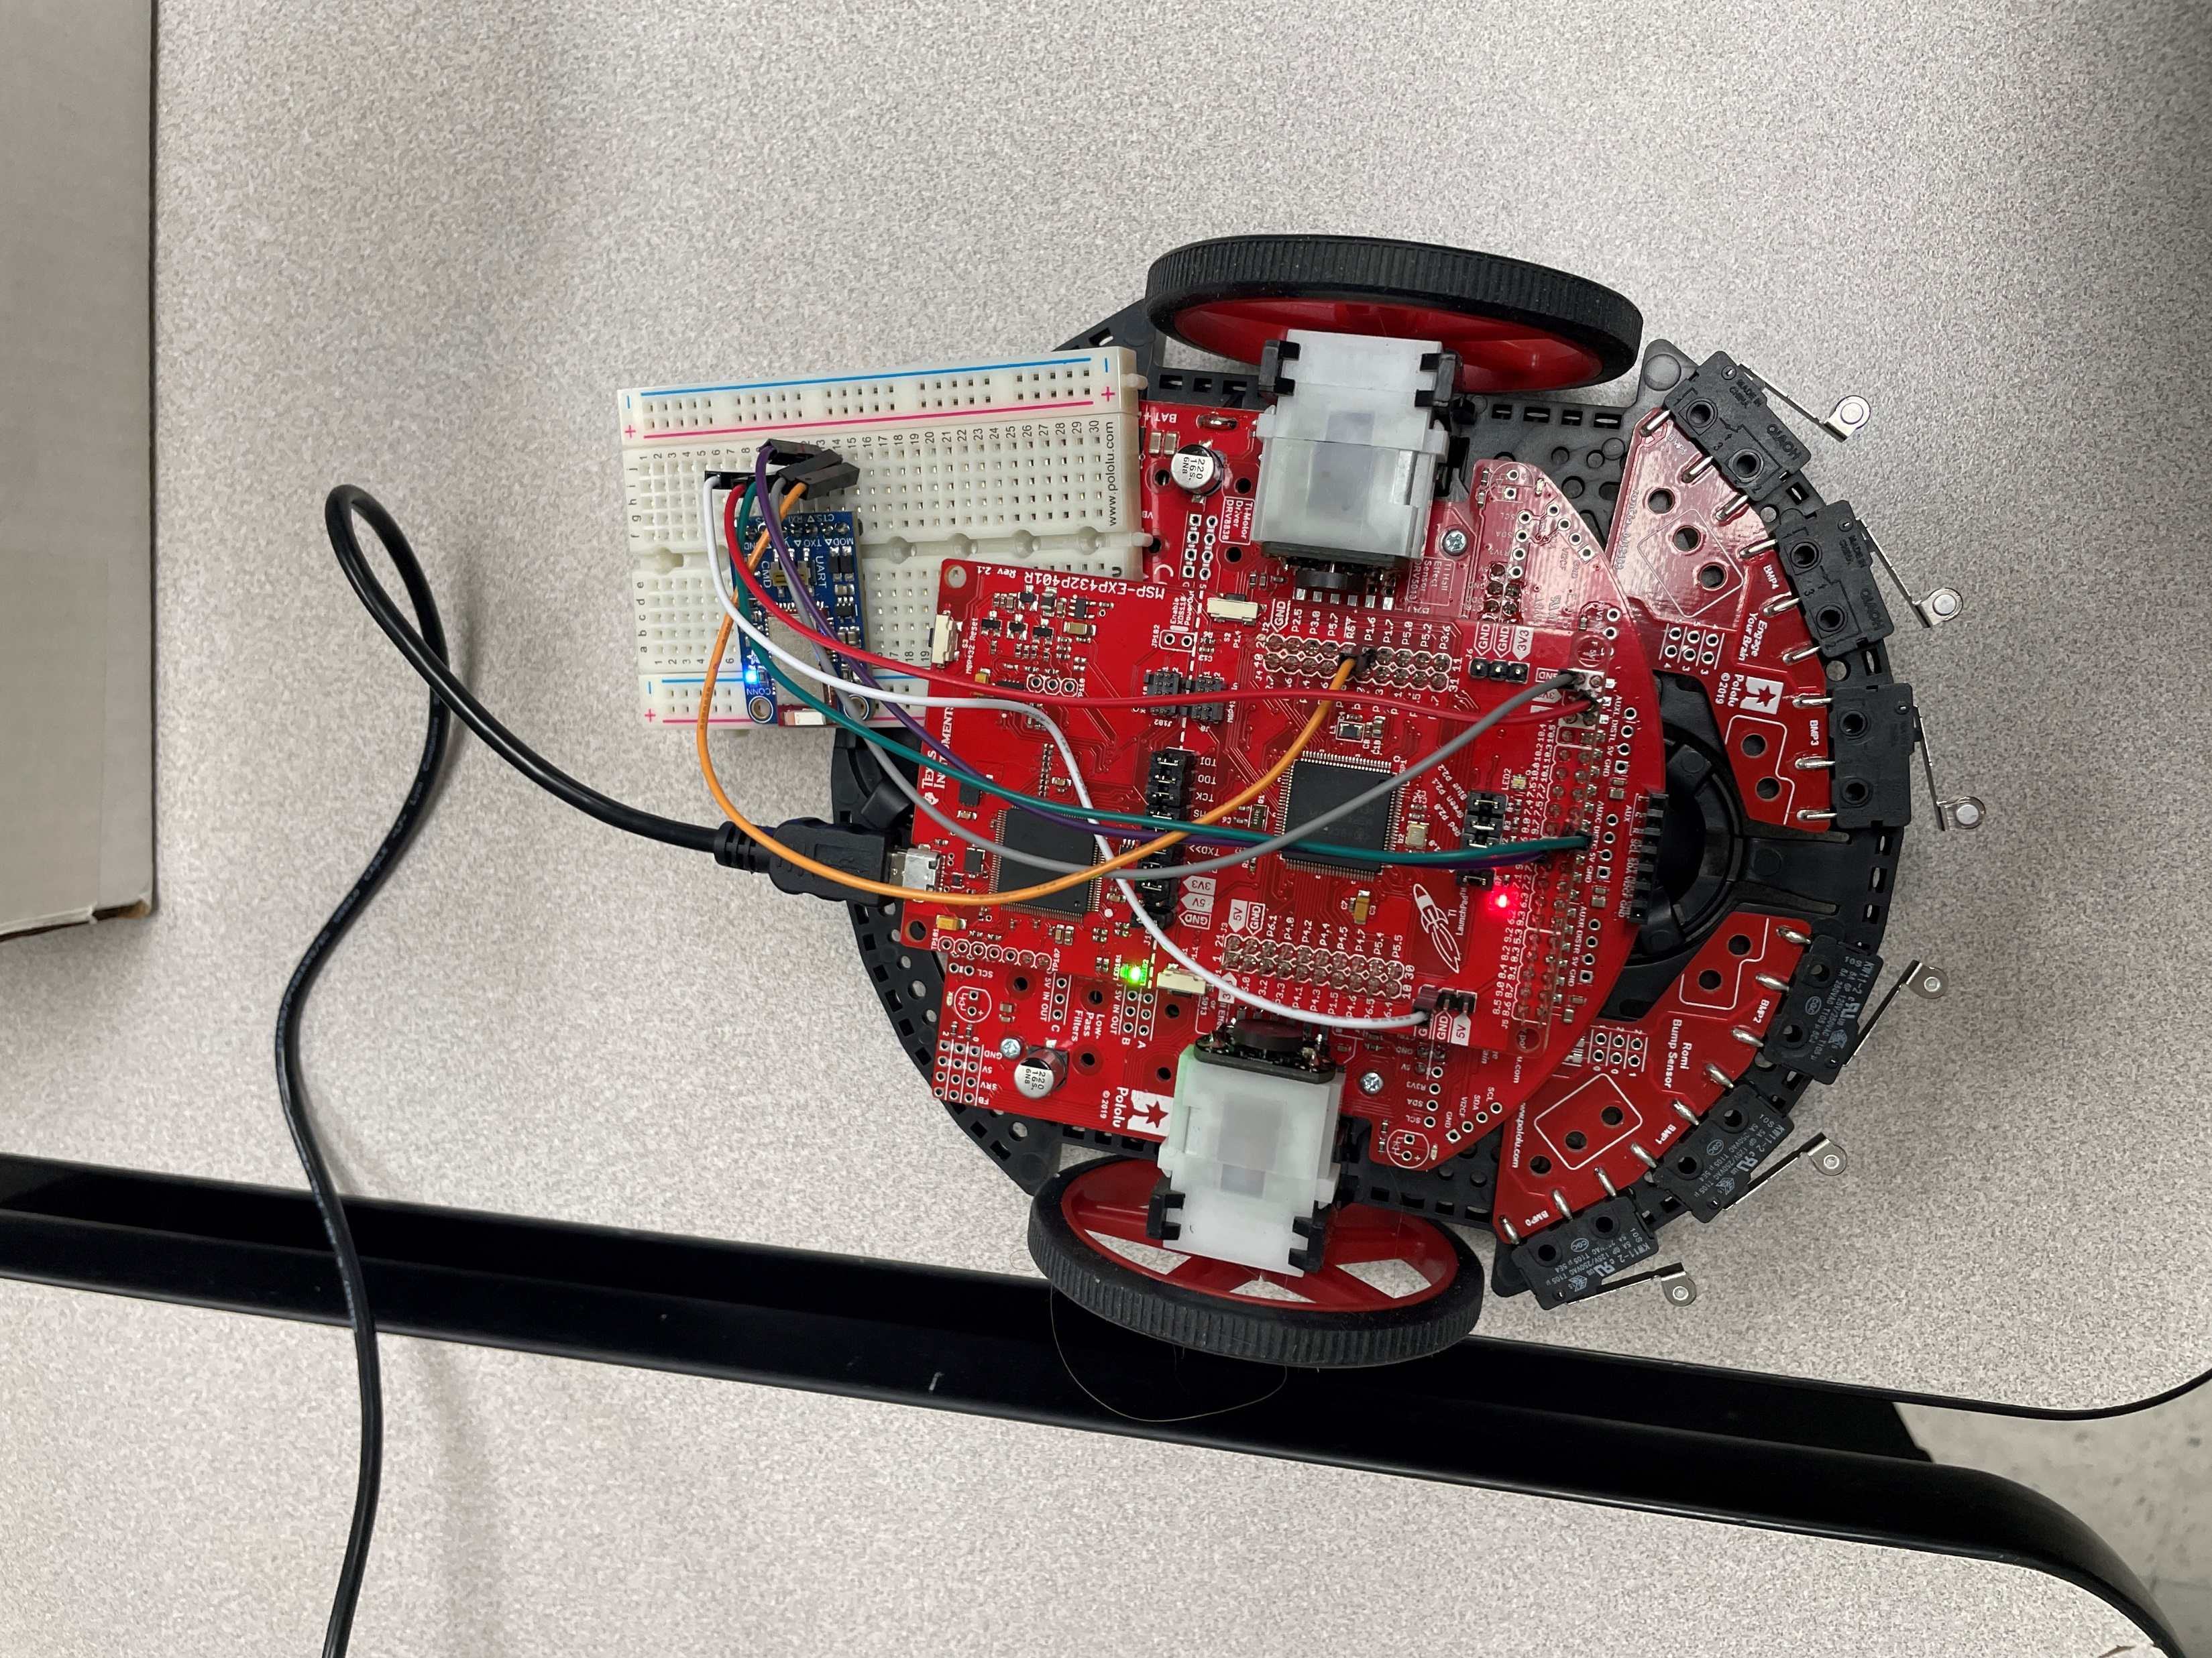
Components:
MSP432 LaunchPad
USB-A to Micro-USB cable
TI-RSLK MAX Chassis
Adafruit BLE UART Module
Jumper Wires
3.3 V DC power supply
iOS Smartphone built in sensors
BluefruitConnect app

Slide 4
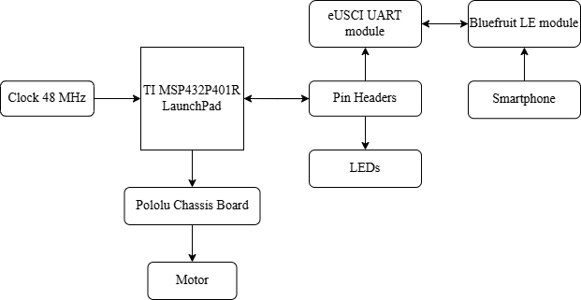
Block Diagram:

Slide 5
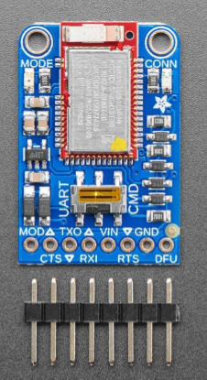
Adafruit BLE UART Module Pinout:
Adafruit BLE UART Module | MSP432 LaunchPad Pin
MOD | P1.6
CTS | GND
TX0 | P9.6(PM_UCA3RXD)
RX1 | P9.7(PM_UCA3TXD)
VIN | 3.3V
RTS | Not Connected(N/C)
GND | Ground
DFU | Not Connected(N/C)

Slide 6
BluefruitConnect App Sensor:
The bluefruitConnect app has controller mode, which provides different ways to send data to bluefruit LE module such as sensor data, color picker, and control pad.
It sends data ten times per second.
Type of sensor data:
Sensor Name | Prefix | Packet Format
Quaternion | !Q | [‘!’] [‘Q’] [float x] [float y] [float z] [float w] [CRC]
Accelerometer | !A | [‘!’] [‘A’] [float x] [float y] [float z] [CRC]
Gyroscope | !G | [‘!’] [‘G’] [float x] [float y] [float z] [CRC]
Magnetometer | !M | [‘!’] [‘M’] [float x] [float y] [float z] [CRC]
Location | !L | [‘!’] [‘L’] [float lat.] [float long.] [float alt.] [CRC]
Sensor Name | Prefix | Packet Format
Quaternion | !Q | [‘!’] [‘Q’] [float x] [float y] [float z] [float w] [CRC]
Accelerometer | !A | [‘!’] [‘A’] [float x] [float y] [float z] [CRC]
Gyroscope | !G | [‘!’] [‘G’] [float x] [float y] [float z] [CRC]
Magnetometer | !M | [‘!’] [‘M’] [float x] [float y] [float z] [CRC]
Location | !L | [‘!’] [‘L’] [float lat.] [float long.] [float alt.] [CRC]

Slide 7
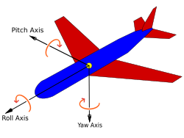
Quaternion Sensor:
Quaternion values are the combined data of the accelerometer, gyroscope, and magnetometer readings.
Used to represent 3-D direction/orientation
All 4 values are limited to [-1,1]
Quaternion Values: {qx, qy, qz, qw}
qx (roll):- tilt forward and backward (+x axis and –x axis)
qy (pitch):- rotate left and right (+y axis and –y axis)
qz (yaw):- move left and right with gravity (+z axis and –z axis)
qw :- real/scalar part of the combined data
https://en.wikipedia.org/wiki/Aircraft_principal_axes

Slide 8
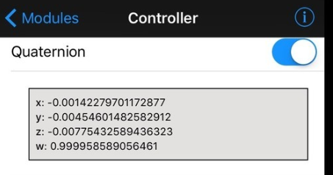
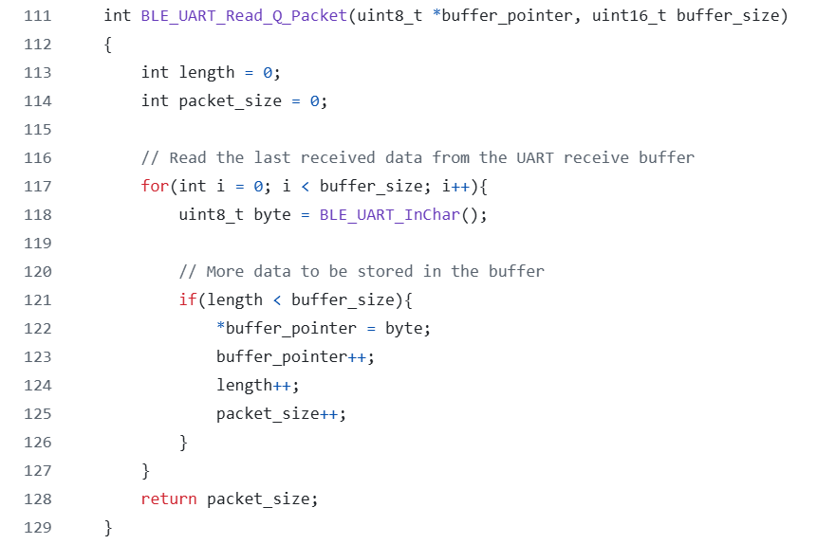
Reading Quaternion Data:
Quaternion packets are sent from the app as:
Format: [‘!’] [‘Q’] [float x] [float y] [float z] [float w] [CRC]
'!', 'Q', and CRC are each 1 byte, each float is 4 bytes -> 19 bytes of data to read.
BLE_UART_Read_Q_Packet: Reads a number of bytes defined by the buffer_size parameter. Stores read bytes into a uint8_t array.
Every 100 ms: Read and process a packet.

Slide 9
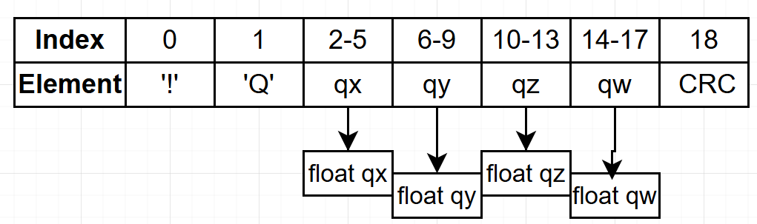
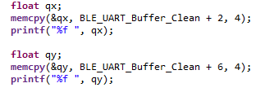
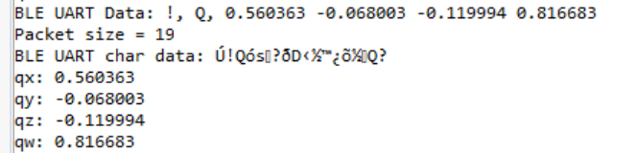
Processing Quaternion Data #1:
We got an unexpected byte at the beginning of each packet
Copied the array into a new array without the 1st byte
Use the memcpy C function to extract the floating point quaternion values
Tilt your phone to the right -> qy increases
Tilt the top/head of your phone up -> qx increases

Slide 10
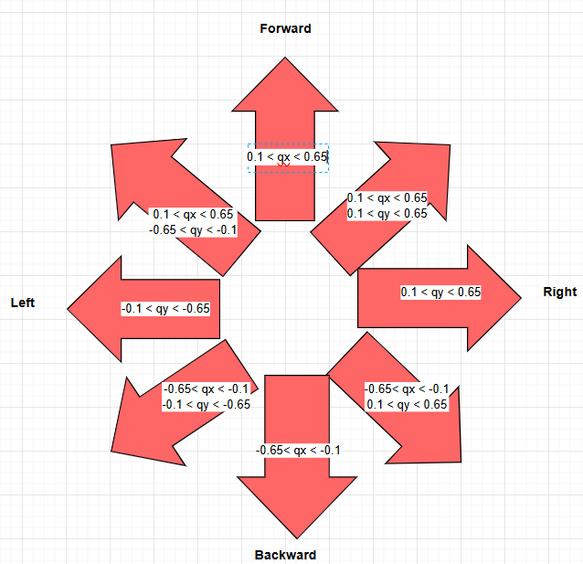
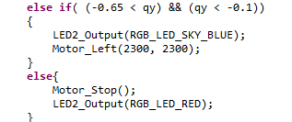
Processing Quaternion Data #2:
Only need qx and qy readings to determine robot movement – 2 dimensional
Use an if-else statement to drive the motors based on the qx and qy values
Check for the diagonal directions first to prevent overlapping
If both qx and qy are in the range [-0.1, 0.1], the motors will stop

Slide 11
Other Elements:
Motor Control
EUSCI_A0
PWM signals from Timer A0 (pins P2.6 and P2.7) to drive the motors
50 Hz PWM signal, counting in up/down mode to 15000 on a 1.5 MHz clock
Toggle/reset mode for the output signals
Duty cycle % = count value / 15000
GPIO output pins P5.4 and P5.5 to control motor direction, P3.6 and P3.7 to enable the motors.
EUSCI_A0 is configured for UART mode
9600 baud rate
8-bit data frame
LSB first
No parity
One stop bit
Synchronous
Transmit and receive interrupts enabled
RGB LED
Pins P2.0-2.2 are output GPIO pins to drive the RGB LED

Slide 12
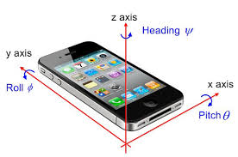
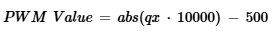
Additional Features
https://www.mdpi.com/2227-7102/5/1/26
"Gesture Control"/Vertical phone control mode
"Remote Control"/Horizontal phone control mode
On board push button to switch between modes
Speed control mode: Works for forward/backward, left/right, but not for diagonal directions
Tilting the phone more increases the robot's speed
To map qx/qy values to a specific speed, we used a linear equation:

Slide 13
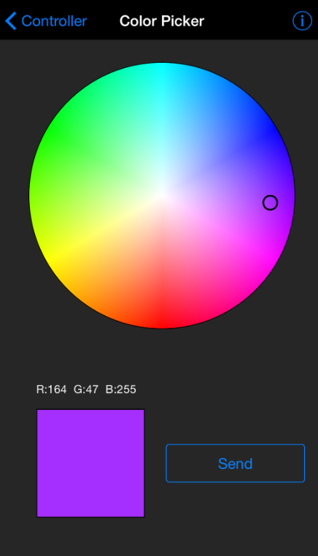
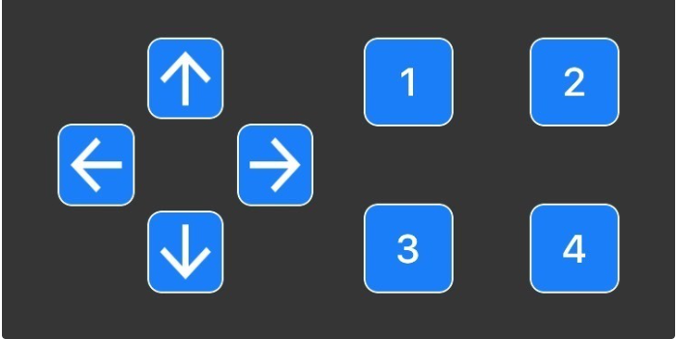
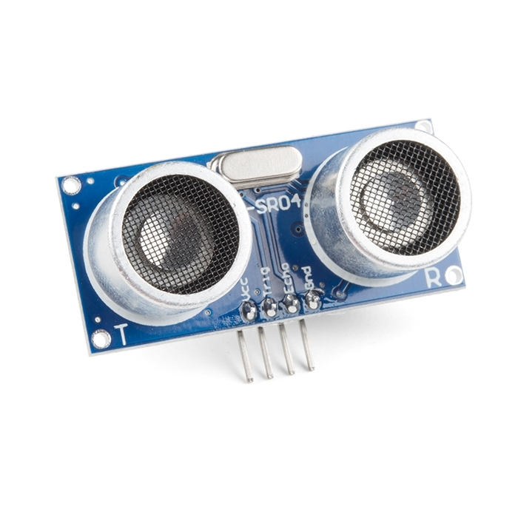
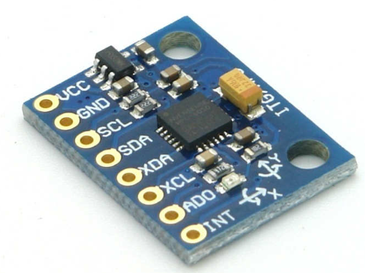
Future Improvements
We can improve this hand-gesture robot by including the distance sensor to avoid obstacles.
We can control robot by using color picker technique or control pad technique.
Implement using a motion sensor, such as the 6050 MPU accelerometer + gyroscope.
Control speed based on how much the phone is tilted

Slide 14
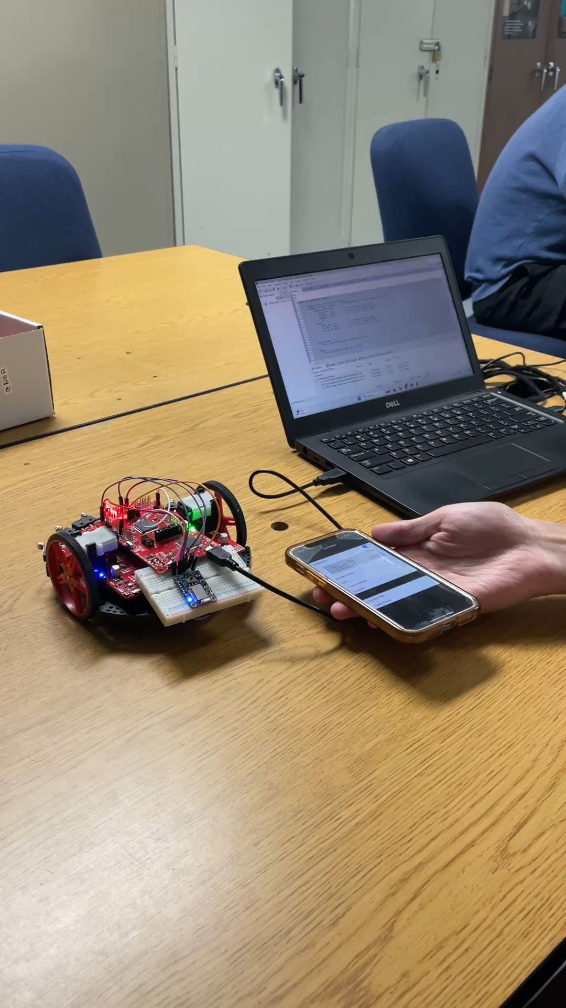

Slide 15
Questions?

